Slide 1
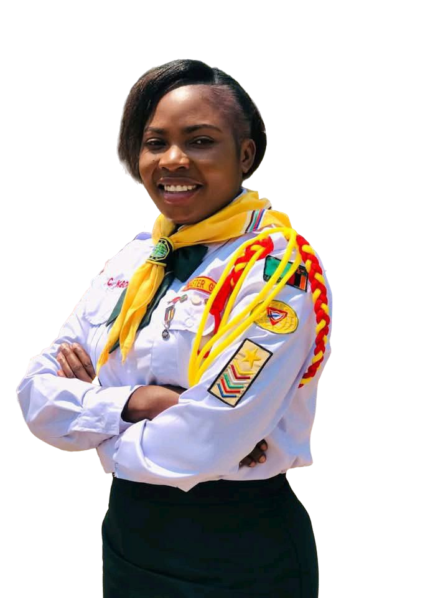


Pathfinders
with Purpose

Slide 2


Pathfinders
with Purpose

Slide 3

“The Lord will fulfill his purpose for me; your love, Lord, endures forever—do not abandon the works of your hands.”
Psalm 138:8, NIV

Slide 4



Happy Sabbath! Today we celebrate Pathfinder Day, joining thousands worldwide in marking 75 years of a ministry that has brought many to Jesus.

Slide 5


In every corner of the planet where there are faithful and brave youth, we boldly proclaim that God has a purpose for each of us as Adventist Pathfinders in these final days.

Slide 6

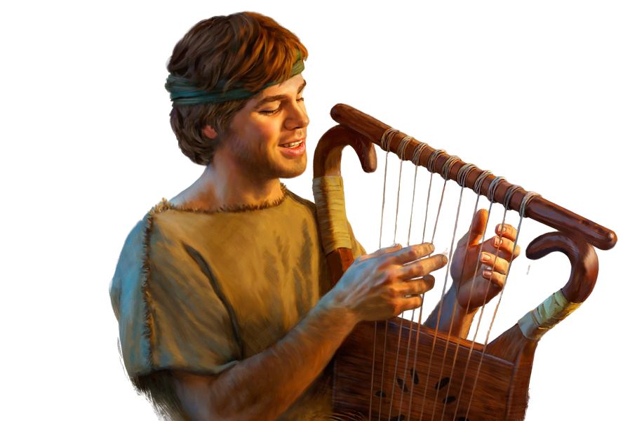
Today, we will talk about a young man just like you.
He wasn't the oldest, the strongest, or the most popular. He spent time tending sheep, singing psalms, and praying.
Yet God chose him for great things. His name was David.

Slide 7


David was a young man with purpose—a true Pathfinder, first in heart before stepping onto the battlefield.
And God wants you to live with purpose too.
Let’s consider several important aspects of his life that offer clear principles on how to be Pathfinders with purpose.

Slide 8
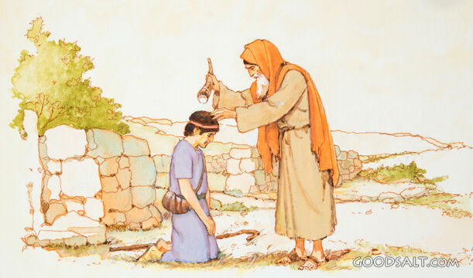
David:
An Ordinary Young Man with an Eternal Calling
Notes:
When the prophet Samuel went to Jesse’s house to anoint the new king, everyone assumed it would be one of David’s older brothers. But God said:

Slide 9

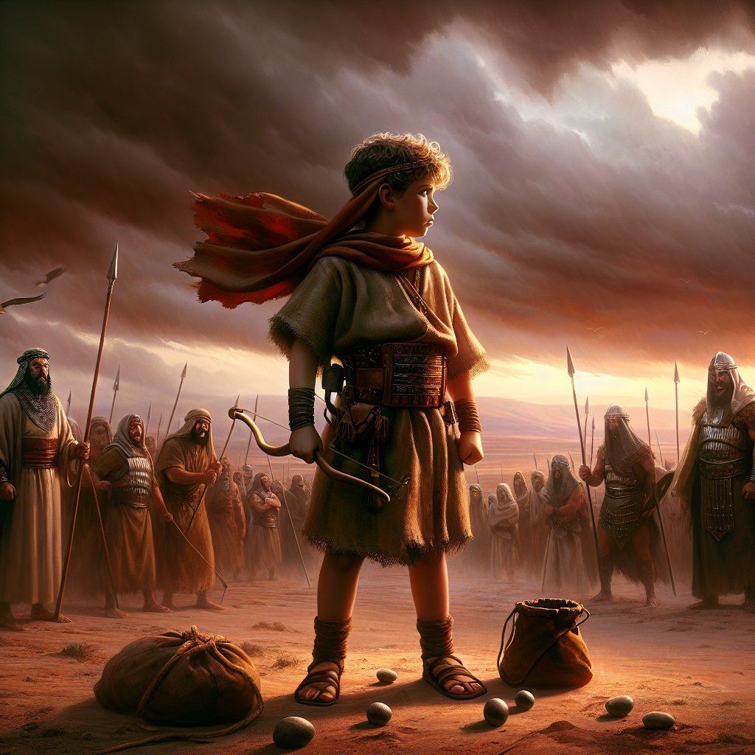
“Do not consider his appearance or his height… People look at the outward appearance, but the Lord looks at the heart.”
— 1 Samuel 16:7, NIV
Notes:
God doesn’t seek appearance—He seeks willingness.
David was tending sheep—a humble job—but while others overlooked him, God was preparing him.

Slide 10

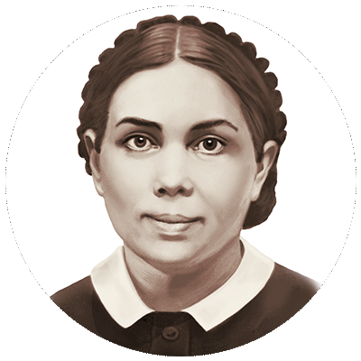
David grew in grace before God and men.
He had been trained in the ways of the Lord and now gave his heart more fully than ever to doing God’s will
Patriarchs and Prophets, p. 632.3

Slide 11

His experiences at court, witnessing Saul’s temptations and the sorrow of his reign, made him reflect deeply.
In moments of anxiety, David took up his harp and lifted his mind to the Author of all good.
Patriarchs and Prophets, p. 632.3

Slide 12

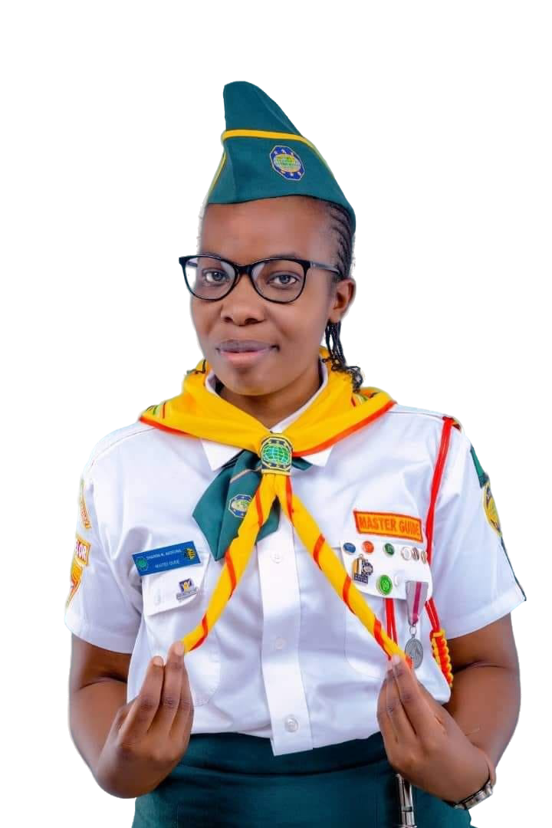
As Adventist Pathfinders, our purpose begins with purifying our hearts before God and transforming our lives into Christ’s image.
Notes:
You may not hold an important position today—but God sees you. Your faithfulness in the little things is shaping your character for greater responsibilities.

Slide 13
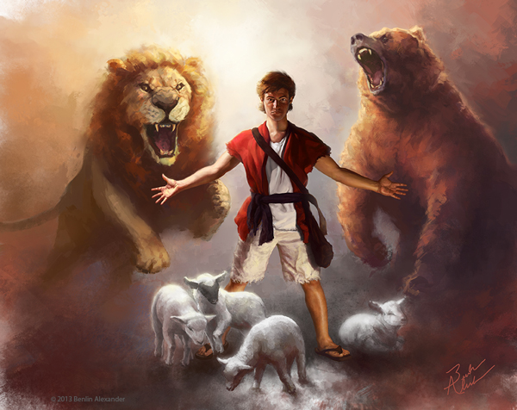
Purpose is Born in Secret
David didn’t start out killing giants.
His early victories were not public.
His purpose began in the fields, tending sheep, composing songs to God, learning to use a sling, and defending his flock from bears and lions.

Slide 14


“Your servant has killed both the lion and the bear…”
— 1 Samuel 17:36, NIV

Slide 15


Before facing Goliath, David had already won silent battles.
When no one was watching, he was faithful. The Spirit of God dwelled in his heart.

Slide 16

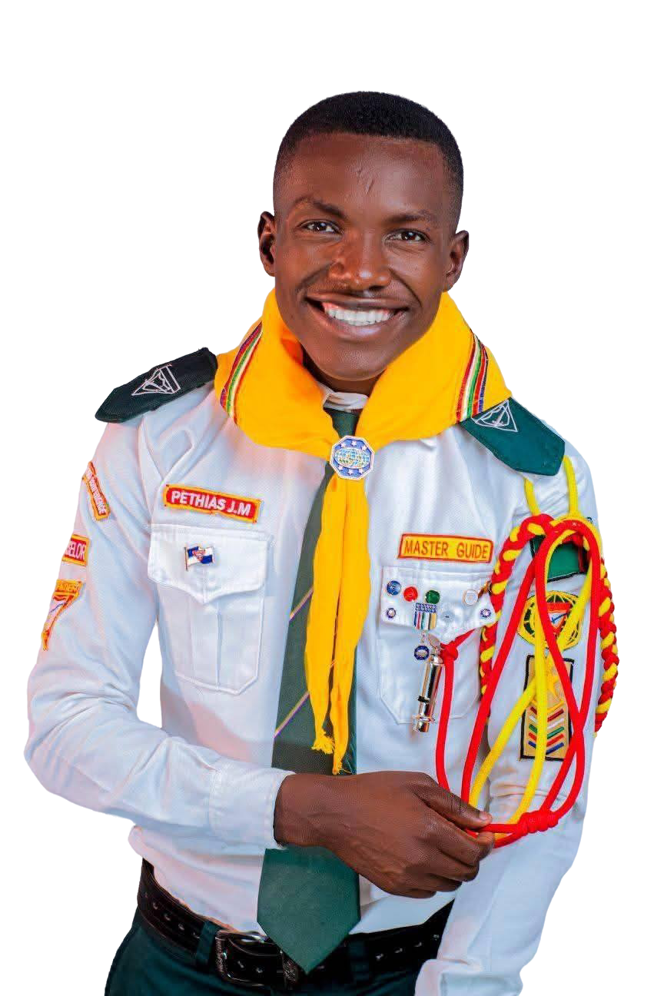
Pathfinders, remember: we can only bring forth what we’ve stored in our hearts when facing pressure—whether from drugs, peer pressure, laziness, or any temptation that threatens our faith
Notes:
If we don’t carry the values of Jesus in our hearts—if we don’t read the Bible, memorize His counsel, or build a personal relationship with our Savior—we won’t be able to stand.
Small, daily decisions—being honest, praying, obeying our parents, resisting temptation—prepare us for bigger challenges.

Slide 17

A Pathfinder with
Purpose Trusts in God
We face big challenges as Pathfinders—in our schools, homes, and communities. Sometimes these challenges feel like giants that disrupt our peace. We all face attacks from the enemy. That’s why we must be alert.
Notes:
In difficult times, remember the Pathfinder Pledge and Law—they will keep you grounded on the right path.

Slide 18
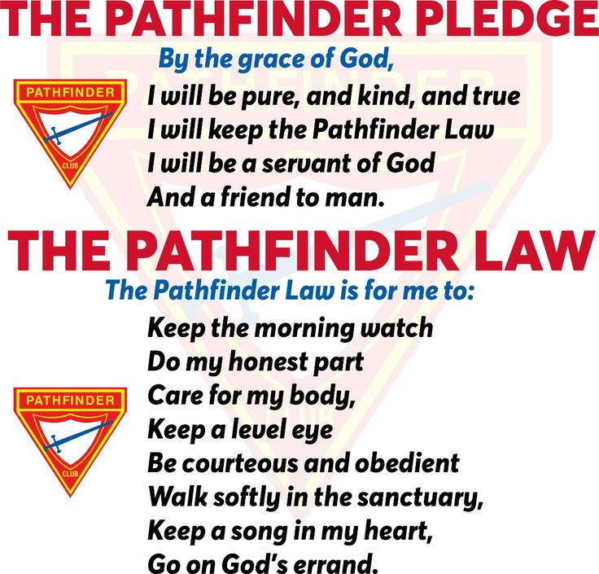
Notes:
Back to David—the Bible says that giant terrified all of Israel. But a young man, loyal to his pledge and law, rose with purpose.

Slide 19


“For forty days the Israelite army had trembled before the Philistine giant’s arrogant challenge…”
(Patriarchs and Prophets, p. 634.2)

Slide 20
David said:
“You come against me with sword and spear and javelin, but I come against you in the name of the Lord Almighty…” — 1 Samuel 17:45, NIV
Notes:
Praise God for the confidence this Pathfinder had in his Creator!
You too can face any challenge in the name of the Lord. A Pathfinder with purpose doesn’t run from giants—they face them with full trust in their God.

Slide 21
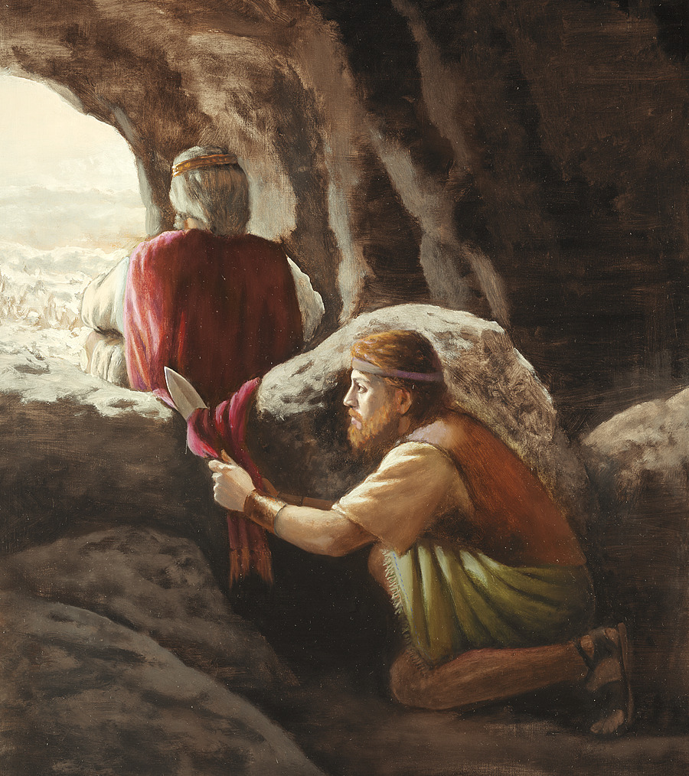
The Path of Purpose is Not Easy
Remember, one great victory doesn’t mean the trials are over.
After killing Goliath, was David crowned king? No! He was pursued for years by King Saul. He lived in caves, was betrayed, and went hungry.
Notes:
If you are going through a difficult season, don’t be discouraged. God is still working in you. The wilderness is not the end—it's part of your preparation as a Pathfinder.

Slide 22
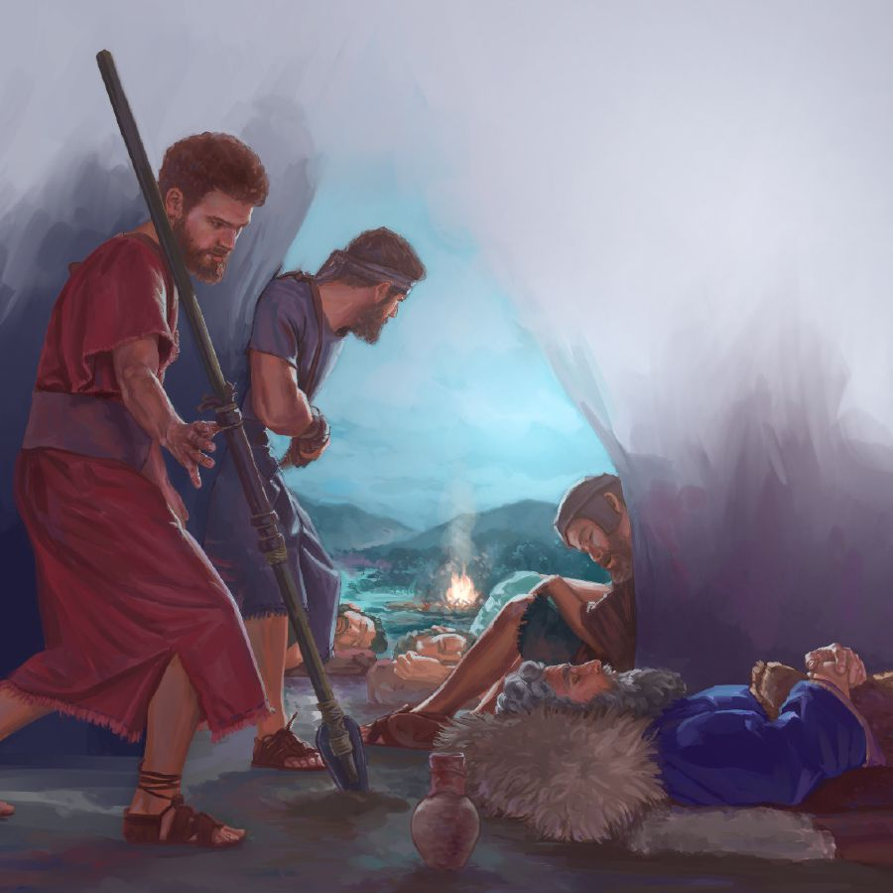
A Pathfinder with
Purpose Honors God
“I will not lay my hand on my lord, because he is the Lord’s anointed.”
— 1 Samuel 24:10, NIV

Slide 23

David had power—but also reverence for God.
He acknowledged authority and respected the Lord’s anointed.

Slide 24
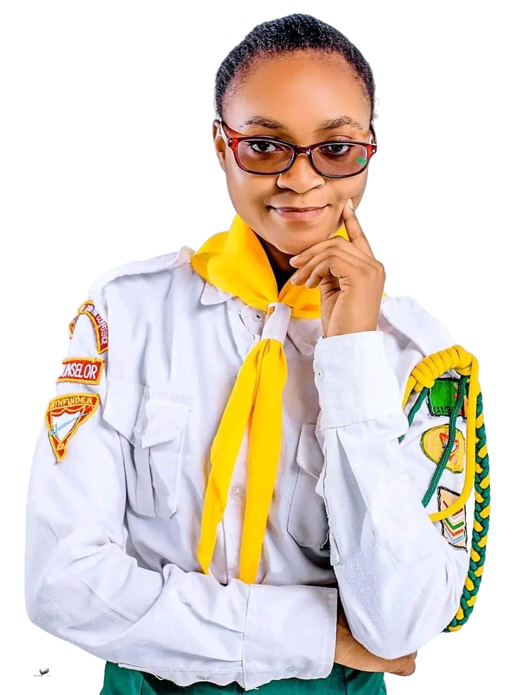
Pathfinders respect their pastors, directors, counselors, parents, teachers, and leaders.
Purpose never justifies doing wrong.
A true Pathfinder with purpose doesn’t just seek results—they seek to please God in everything.

Slide 25
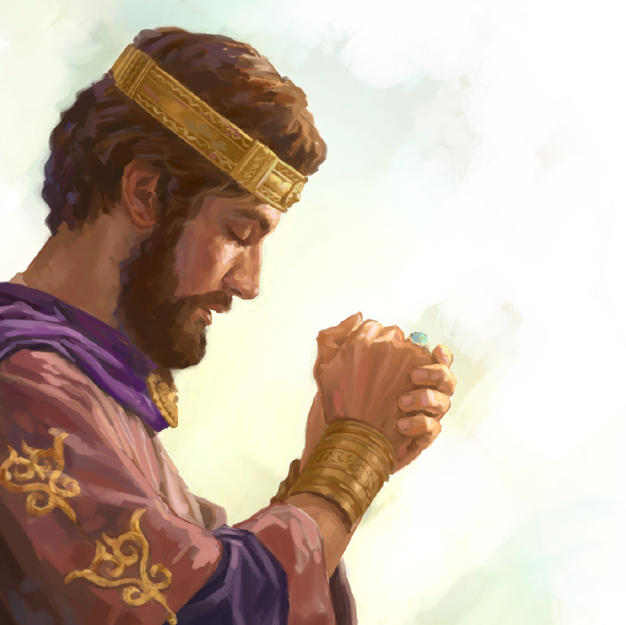
God Fulfills His Purpose
Eventually, David was crowned king. But the greatest honor wasn’t the throne—it was that from his lineage came Jesus, our Savior.

Slide 26

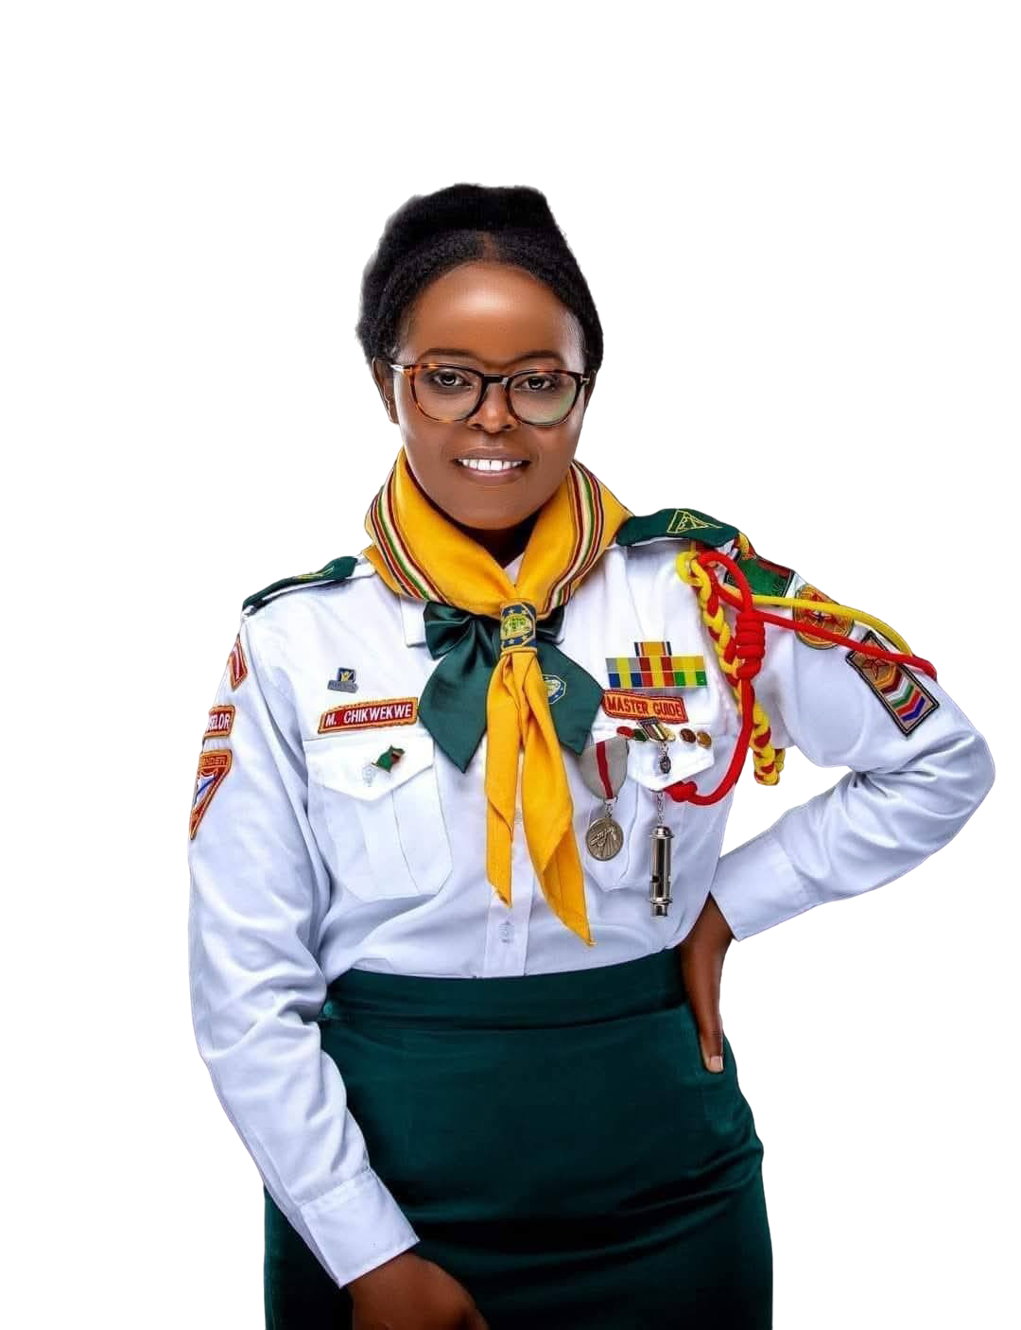
“The Lord will fulfill his purpose for me…”
— Psalm 138:8, NIV
Notes:
Because of David’s faithfulness, his life was woven into the plan of redemption.
What a beautiful reality: from the life of this strong and faithful Pathfinder, our Savior Jesus was born. He is our only example of how to be youth of great victories, faithful as the compass to the pole.
You and I are part of the final generation of Pathfinders on this earth. Jesus, our Great Master Guide, is coming soon for us.

Slide 27

Pathfinders with Purpose
You may be in your sheep field today—your school, your home, your club, or your community.
Maybe no one sees what you do… but God does.

Slide 28

Maybe you're facing giants—bullying, temptation, fear, insecurity…
But if you walk with God, His purpose will be fulfilled.

Slide 29

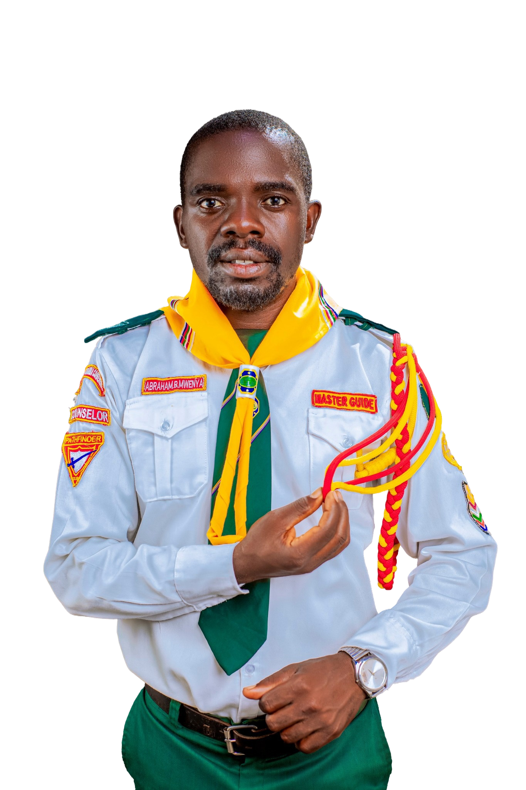
Tell the Lord:
“Here I am.
Use my life.
I want to fulfill Your purpose.”
Notes:
Before we pray, let’s repeat the key verse for this Pathfinder Day:
“The Lord will fulfill his purpose for me; your love, Lord, endures forever—do not abandon the works of your hands.” — Psalm 138:8, NIV
Closing Prayer
Lord,
Today I come before You as a Pathfinder. I am not perfect, but I want to live with purpose. I want everything You’ve planned for me to come true.
I ask that, just as You did with David, You guide my life according to Your purpose. Let only Your perfect plans be fulfilled in me.
Help me so that through my testimony, as a strong and faithful Pathfinder, I can lead others to the feet of Jesus.
And when You appear in the clouds of heaven, may I live with You forever.
We ask this in the name of Jesus, our Savior.
Amen.

Slide 30


Slide 31



PowerPoint Developed by
Pastor Sintim-Aboagye Eric
+233 549 590 403
pasesaboagye@gmail.com

